Slide 1
CLOUD Agnostic platform
-By Prashanth Reddy

Slide 2
ABOUT Platform
This Platform helps us to upload and download files the are stored in respective clouds like AWS GCP AZURE.
The User can access files the are uploaded by the user.
Authentication was done basis on generated token

Slide 3
PROBLEM STATEMENT
-> The current solution processes backend requests and generates reports in .pdf, .csv, or .pdm file formats. These reports are then uploaded on an on-premises shared file server. Since the solution is now hosted on cloud, a file-server-based model is not the optimum solution for file storage.
-> Though transitioning file storage from on-premises to cloud can be achieved easily, clients have their choices of cloud provider, which requires customization for every transition. A cloud-agnostic storage solution can address this problem.
-> To build a solution that is agnostic of the cloud provider for storing and retrieving files, i.e. one solution that supports storage and retrieval of files from AWS S3 bucket, Azure Blob storage, or Google Cloud storage.

Slide 4
SOLUTION DETAILS
PROGRAMMING
This was developed using Python(Flask) .
FRONTEND
The Frontend was developed using HTML and JavaScript for UI
DATABASE
The Database used in Project was PostgreSQL
CLOUD
This Project Supports AWS, GCP, AZURE

Slide 5
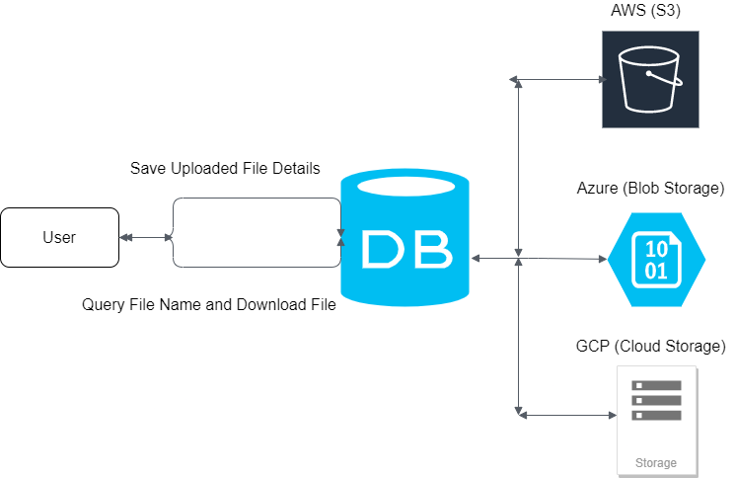
PLATFORM OVERALL FLOW

Slide 6
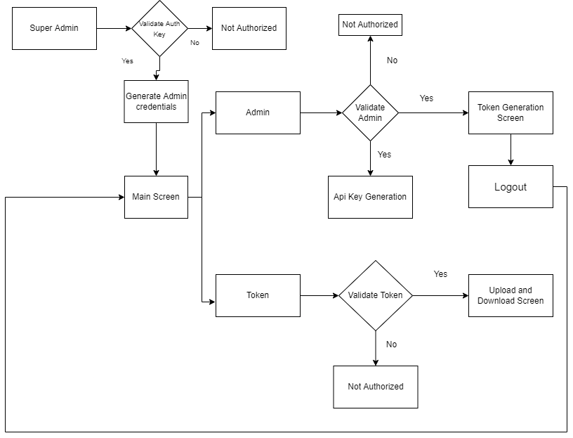
PLATFORM FLOW

Slide 7
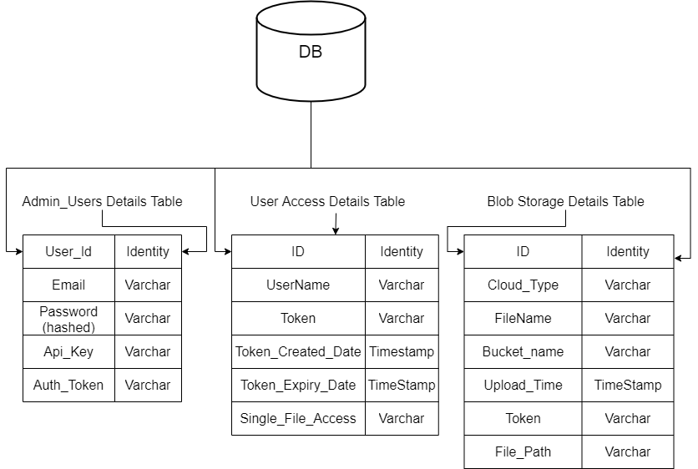
DB Schema

Slide 8
THANK YOU
Prashanth Reddy
+918247222816
mprashanth059@gmail.com

